Slide 1
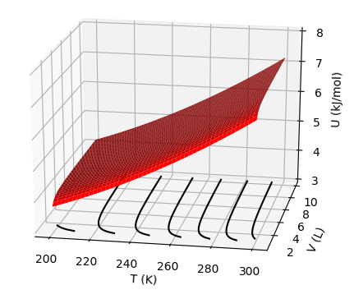


Week 4 – $U(T,V)$as a thermodynamic surface
$${\left(\frac{∂U}{∂T}\right)}_{V}$$
$${\left(\frac{∂U}{∂V}\right)}_{T}$$
$$dU=C_{V}dT+π_{T}dV$$

Slide 2
$\text{Week}\text{ 4 – }U(T,V)$as a thermodynamic surface
$${\left(\frac{∂U}{∂T}\right)}_{V}$$
$${\left(\frac{∂U}{∂V}\right)}_{T}$$
$$dU=C_{V}dT+π_{T}dV$$

Slide 3
$\text{Week}\text{ 4 – }U(T,V)$as a thermodynamic surface
$${\left(\frac{∂U}{∂T}\right)}_{V}$$
$${\left(\frac{∂U}{∂V}\right)}_{T}$$
$$dU=C_{V}dT+π_{T}dV$$

Slide 4
$\text{Week}\text{ 4 –} U(T,V)$as a thermodynamic surface
$${\left(\frac{∂U}{∂T}\right)}_{V}$$
$${\left(\frac{∂U}{∂V}\right)}_{T}$$
$$dU=C_{V}dT+π_{T}dV$$
As temperature goes up, Total energy (U) goes up

Slide 5
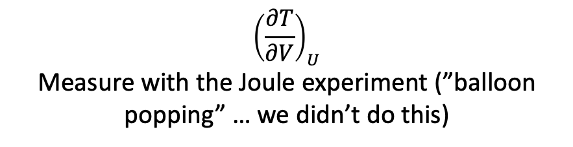
Week 4 – $U(T,V)$as a thermodynamic surface
$${\left(\frac{∂U}{∂T}\right)}_{V}$$
$${\left(\frac{∂U}{∂V}\right)}_{T}$$
$$dU=C_{V}dT+π_{T}dV$$
$${\left(\frac{∂T}{∂V}\right)}_{U}$$
Measure with the Joule experiment (”balloon popping” … we didn’t do this)

Slide 6
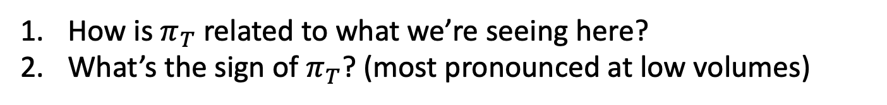
The kind of question I might ask
How is $π_{T}$ related to what we’re seeing here?
What’s the sign of $π_{T}$? (most pronounced at low volumes)

Slide 7

The kind of question I might ask
${\left(\frac{∂U}{∂T}\right)}_{V}$
${\left(\frac{∂T}{∂V}\right)}_{U}$
${\left(\frac{∂U}{∂V}\right)}_{T}$
Which is the correct description of the slopes of these lines?

Slide 8
Week 6 - 1st law
$$dU=dq+dw$$
This is the same $U(T,V)$ that we’ve been talking about
If $dq+dw$ is positive, the energy of the system goes up
If $dq+dw$ is negative, the energy of the system goes down
If changes are large, we say $∆U=q+w$
$$U(T,V)$$
V
T

Slide 9
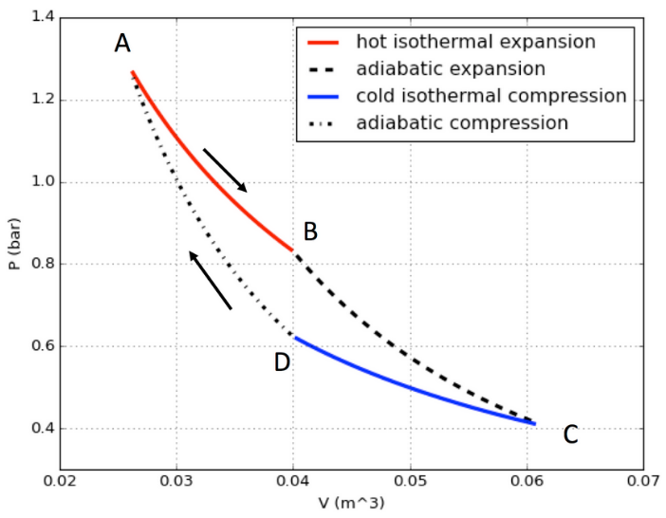






Week 6 - Thermal power generators (in Thermo, “heat engines”)
The observed efficiency is defined as
$${ε_{obs} ≡−w}_{tot}/q_{hot}$$
$$q_{1}$$
$$q_{4}=0$$
The maximum possible efficiency is
$$ε_{max}=∆T/T_{hot}$$
$$q_{2}=0$$
$$q_{3}$$

Slide 10
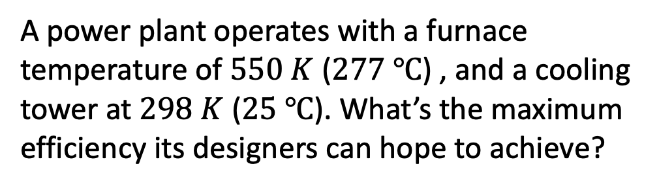




The kind of question I might ask
$$q_{1}$$
$$q_{4}=0$$
A power plant operates with a furnace temperature of $550 K$ ($277 ℃$) , and a cooling tower at $298 K$ ($25 ℃$). What’s the maximum efficiency its designers can hope to achieve?
$$q_{2}=0$$
$$q_{3}$$

Slide 11


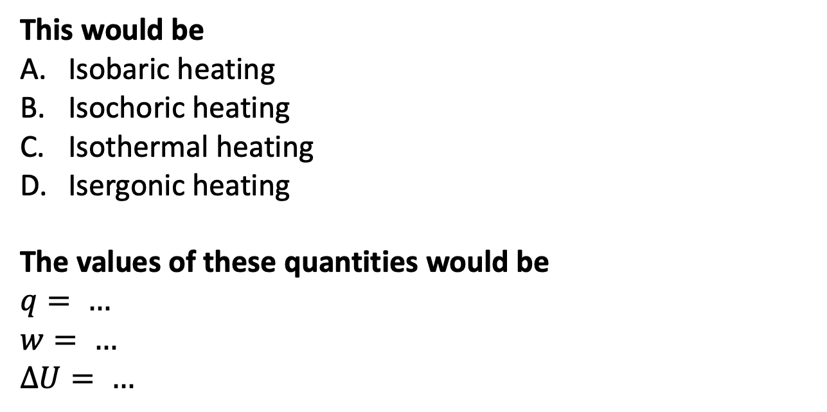
The kind of question I might ask
$T_{surr}>T$
$50 J$ of heat go in,
keeping the volume fixed
$$U(T,V)$$
$$T_{surr}$$
V
This would be
Isobaric heating
Isochoric heating
Isothermal heating
Isergonic heating
The values of these quantities would be
$$q= …$$
$w= …$
$∆U= …$
T
T
(system)

Slide 12
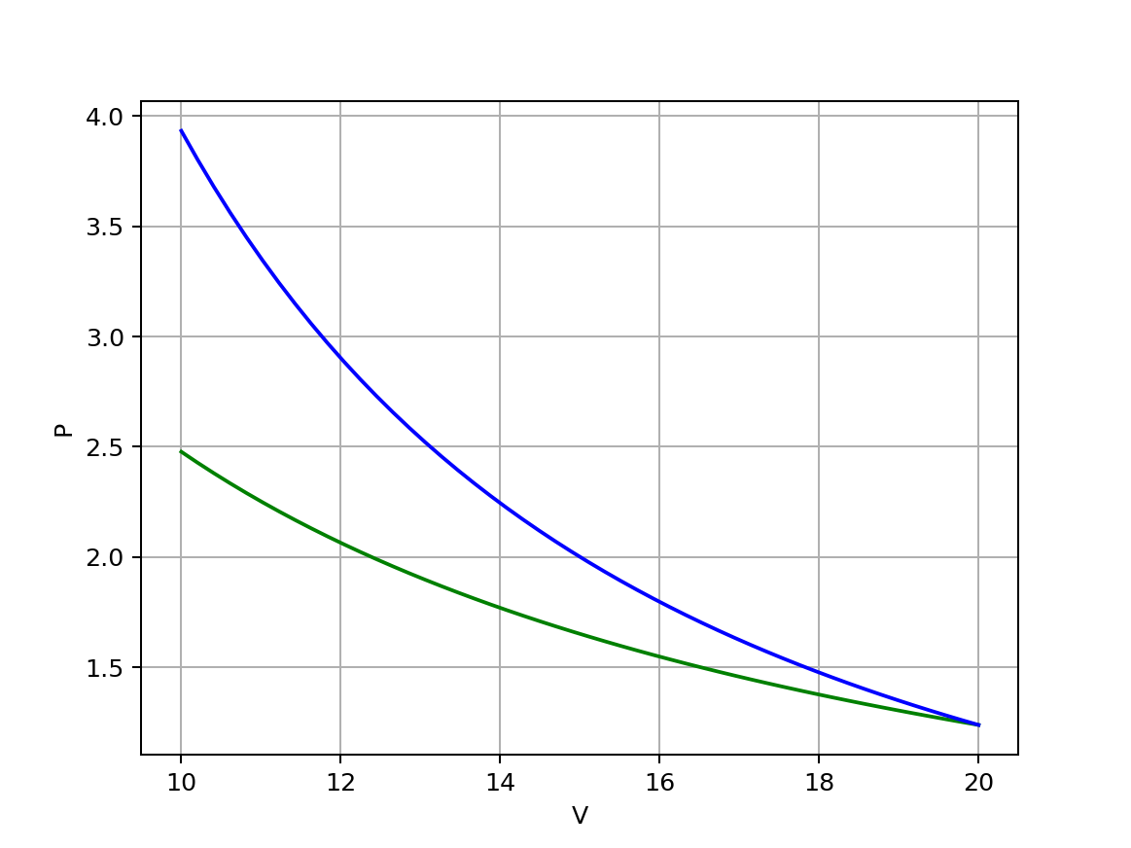
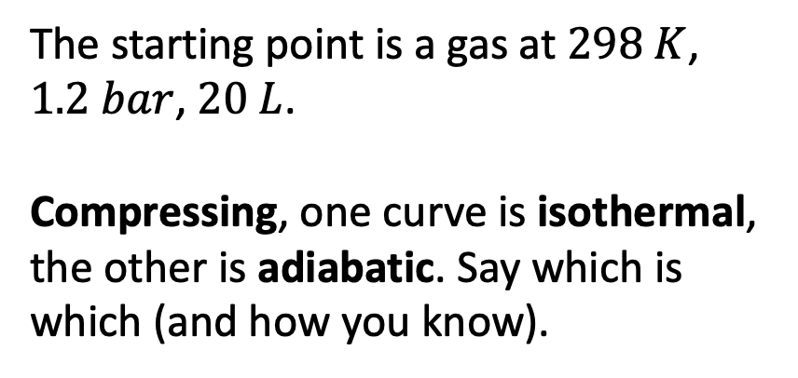
The kind of question I might ask
The starting point is a gas at $298 K$, $1.2 bar$, $20 L$.
Compressing, one curve is isothermal, the other is adiabatic. Say which is which (and how you know).

Slide 13
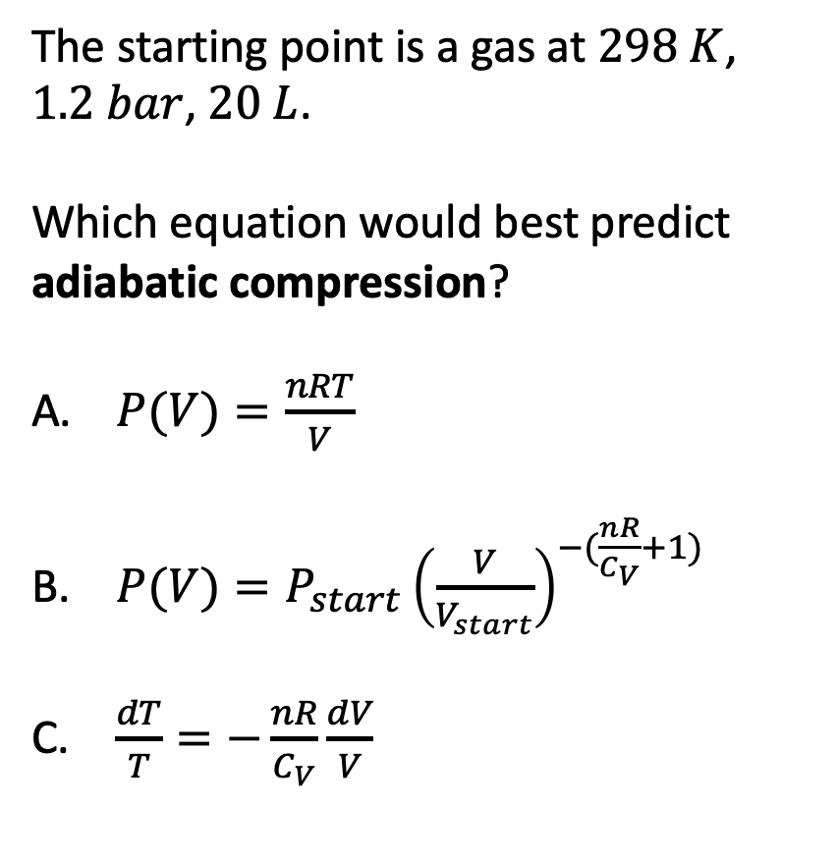
The kind of question I might ask
The starting point is a gas at $298 K$, $1.2 bar$, $20 L$.
Which equation would best predict adiabatic compression?
$P(V)=\frac{nRT}{V}$
$P(V)=P_{start}{\left(\frac{V}{V_{start}}\right)}^{−(\frac{nR}{C_{V}}+1)}$
$\frac{dT}{T}=−\frac{nR}{C_{V}}\frac{dV}{V}$

Slide 14
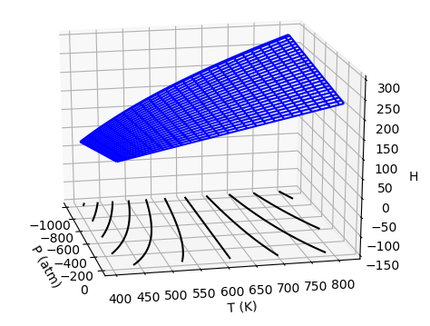


Week 7 – $H(T,P)$as a thermodynamic surface
$${\left(\frac{∂H}{∂T}\right)}_{P}$$
$${\left(\frac{∂H}{∂P}\right)}_{T}$$
Pressure
Temperature
$$dH=C_{P}dT+μ_{T}dP$$

Slide 15
Week 7 – $H(T,P)$as a thermodynamic surface
$${\left(\frac{∂H}{∂T}\right)}_{P}$$
$${\left(\frac{∂H}{∂P}\right)}_{T}$$
Pressure
Temperature
$$dH=C_{P}dT+μ_{T}dP$$

Slide 16
Week 7 – $H(T,P)$as a thermodynamic surface
$${\left(\frac{∂H}{∂T}\right)}_{P}$$
$${\left(\frac{∂H}{∂P}\right)}_{T}$$
Pressure
Temperature
$$dH=C_{P}dT+μ_{T}dP$$
As temperature goes up, Enthalpy (H) goes up

Slide 17
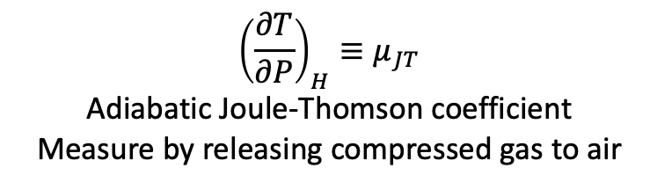
Week 7 – $H(T,P)$as a thermodynamic surface
$${\left(\frac{∂H}{∂T}\right)}_{P}$$
$${\left(\frac{∂H}{∂P}\right)}_{T}$$
Pressure
Temperature
$$dH=C_{P}dT+μ_{T}dP$$
$${\left(\frac{∂T}{∂P}\right)}_{H}≡μ_{JT}$$
Adiabatic Joule-Thomson coefficient
Measure by releasing compressed gas to air

Slide 18
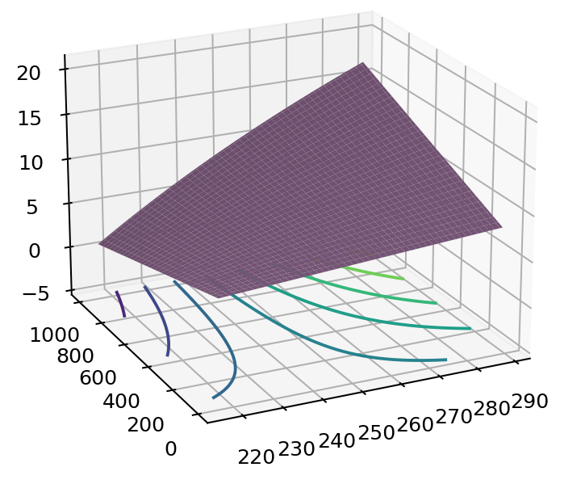


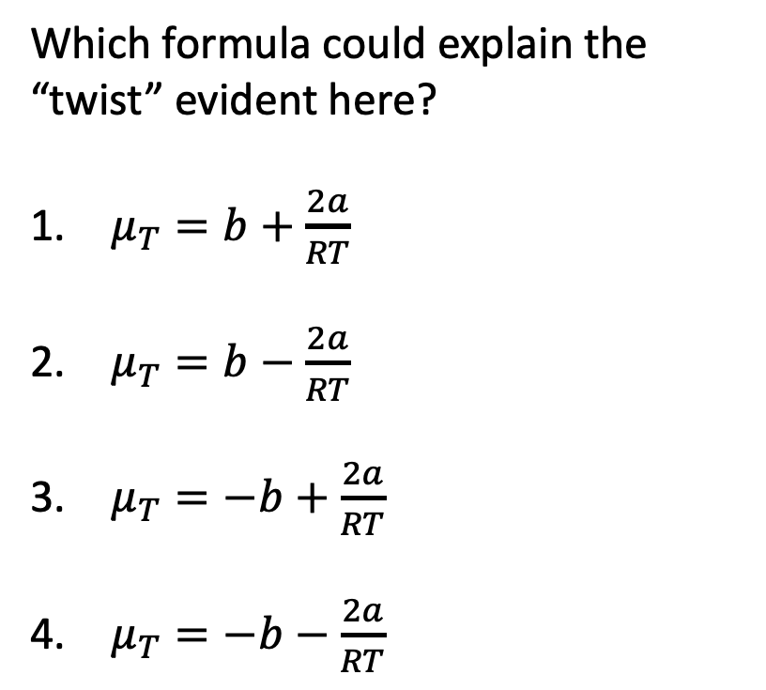
The kind of question I might ask
$$H$$
Which formula could explain the “twist” evident here?
$μ_{T}=b+\frac{2a}{RT}$
$μ_{T}=b−\frac{2a}{RT}$
$μ_{T}=−b+\frac{2a}{RT}$
$μ_{T}=−b−\frac{2a}{RT}$
P
T
$$dH=C_{P}dT+μ_{T}dP$$

Slide 19
The kind of question I might ask
$$H$$
The contours are called
Isentropes
Isochores
Isobars
Isenthalps
Isotherms
P
T

Slide 20
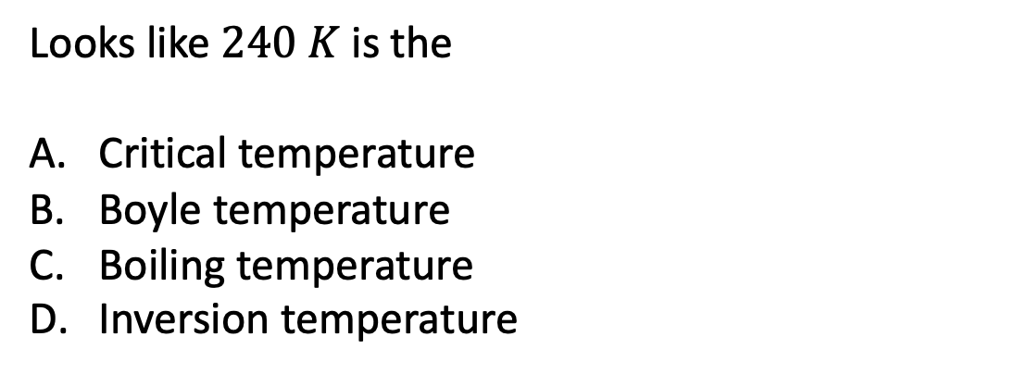
The kind of question I might ask
$$H$$
Looks like $240 K$ is the
Critical temperature
Boyle temperature
Boiling temperature
Inversion temperature
H
P
T

Slide 21
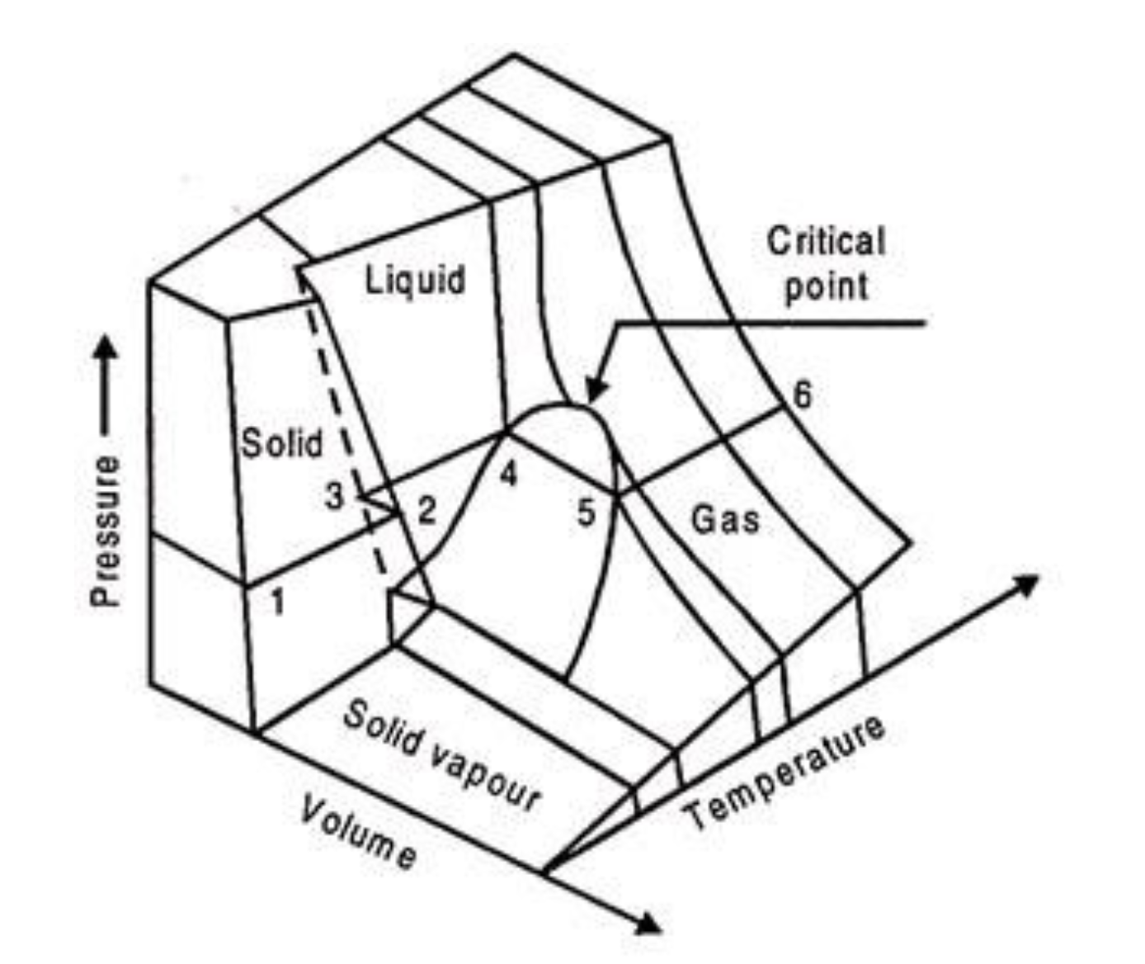
The kind of question I might ask
The process at left corresponds to which curve?
Red
Blue
Orange
Green
gas
gas
liquid
liquid
Isothermal compression

Slide 22
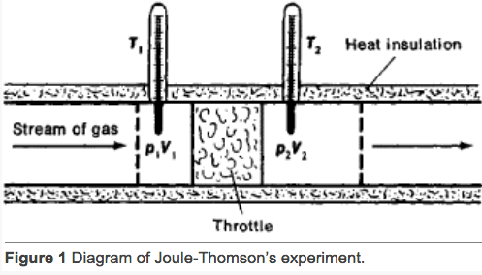
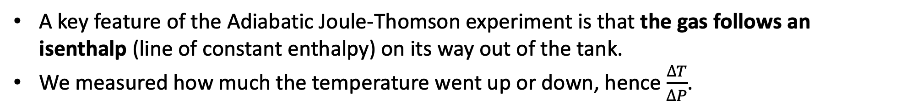
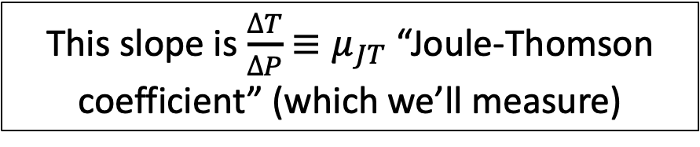
Week 8 – The Adiabatic Joule-Thomson experiment
A key feature of the Adiabatic Joule-Thomson experiment is that the gas follows an isenthalp (line of constant enthalpy) on its way out of the tank.
We measured how much the temperature went up or down, hence $\frac{∆T}{∆P}$.
https://encyclopedia2.thefreedictionary.com/Joule-Thomson+Effect
This slope is $\frac{∆T}{∆P}$ ${≡μ}_{JT}$ “Joule-Thomson coefficient” (which we’ll measure)

Slide 23
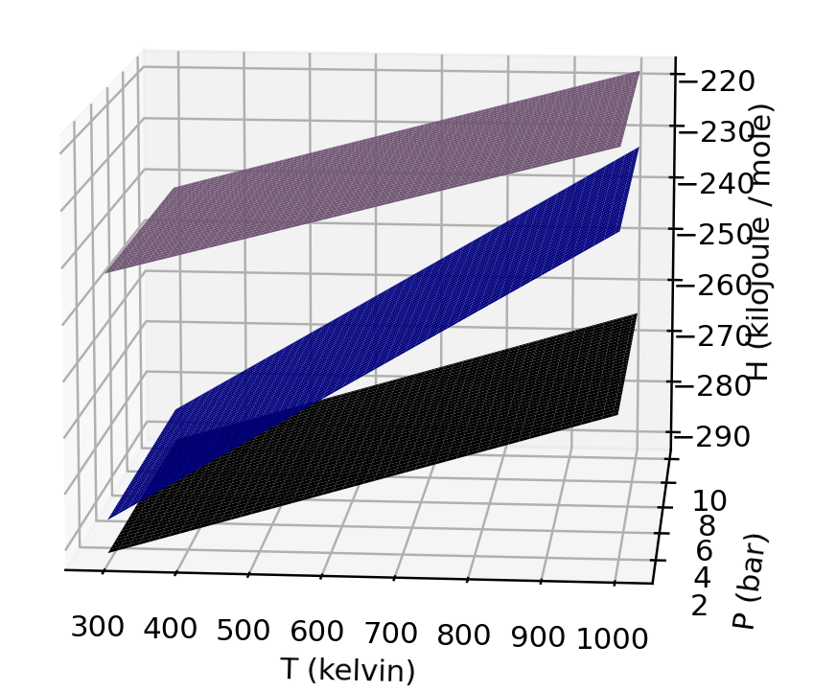

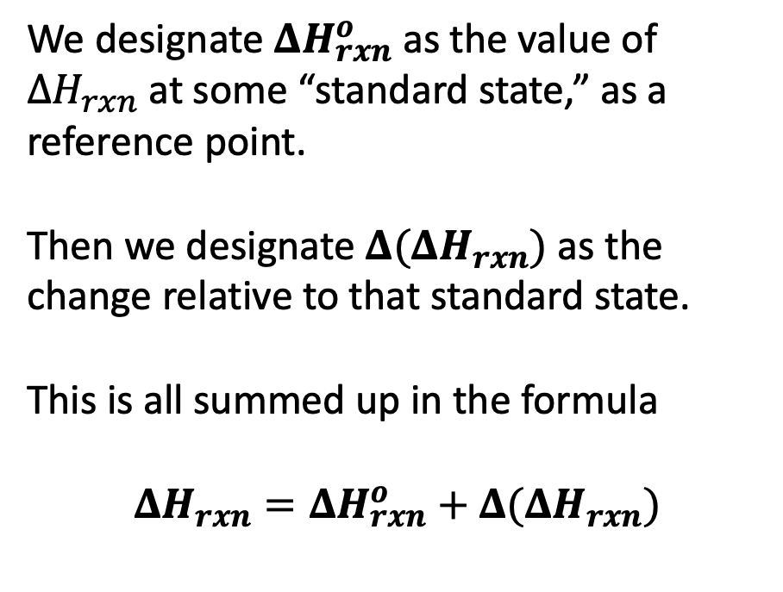

Week 8 – $ΔH_{rxn}$ and $Δ(ΔH_{rxn})$
We designate $ΔH_{rxn}^{o}$ as the value of ${ΔH}_{rxn}$at some “standard state,” as a reference point.
Then we designate $Δ(ΔH_{rxn})$ as the change relative to that standard state.
This is all summed up in the formula
$$ΔH_{rxn}=ΔH_{rxn}^{o}+Δ(ΔH_{rxn})$$
gas
liquid
$$ΔH_{vap}$$
$$ΔH_{vap}^{o}$$
solid

Slide 24
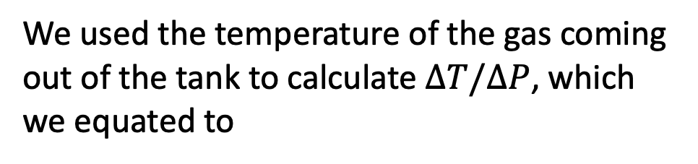
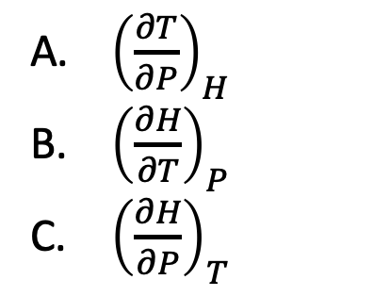
The kind of question I might ask
$$H$$
H
We used the temperature of the gas coming out of the tank to calculate $∆T/∆P$, which we equated to
P
T
${\left(\frac{∂T}{∂P}\right)}_{H}$
${\left(\frac{∂H}{∂T}\right)}_{P}$
${\left(\frac{∂H}{∂P}\right)}_{T}$

Slide 25
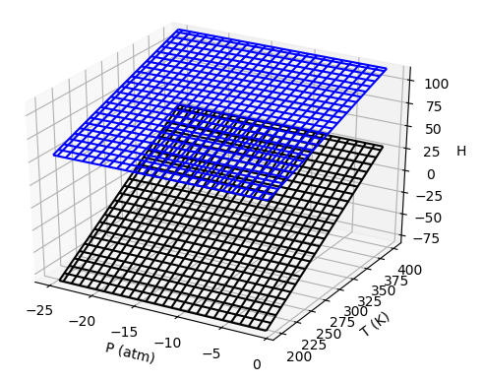
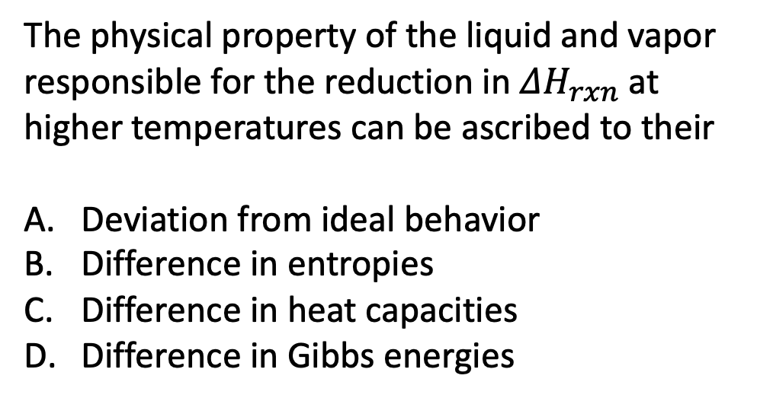
The kind of question I might ask
Upper surface is vapor
The physical property of the liquid and vapor responsible for the reduction in $ΔH_{rxn}$ at higher temperatures can be ascribed to their
Deviation from ideal behavior
Difference in entropies
Difference in heat capacities
Difference in Gibbs energies
Lower surface is liquid

